Slide 1
Computational Intelligence and Machine Learning
Anupama Sindgi

Slide 2
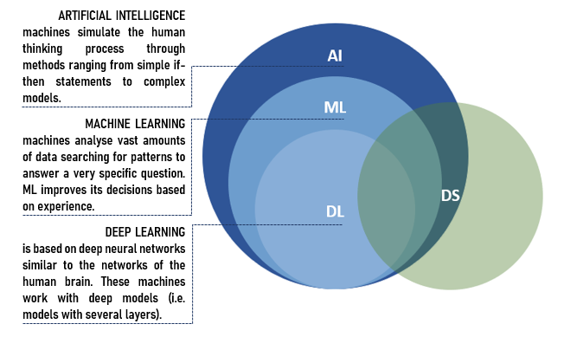

Slide 3
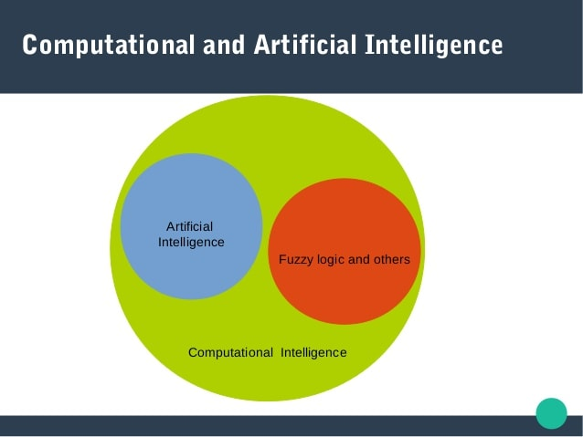
Introduction

Slide 4
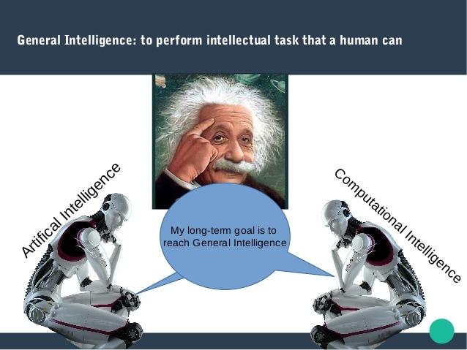

Slide 5
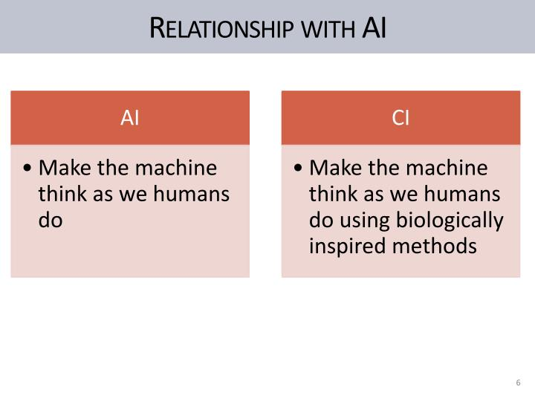

Slide 6
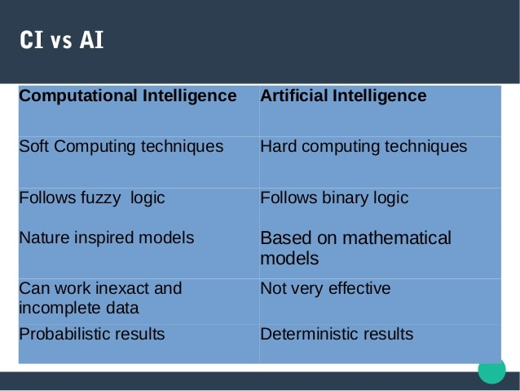

Slide 7
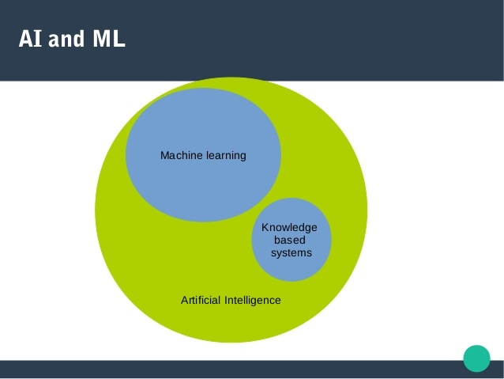

Slide 8
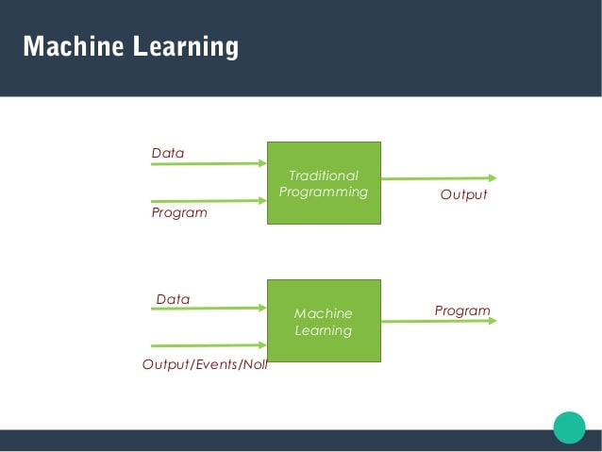

Slide 9
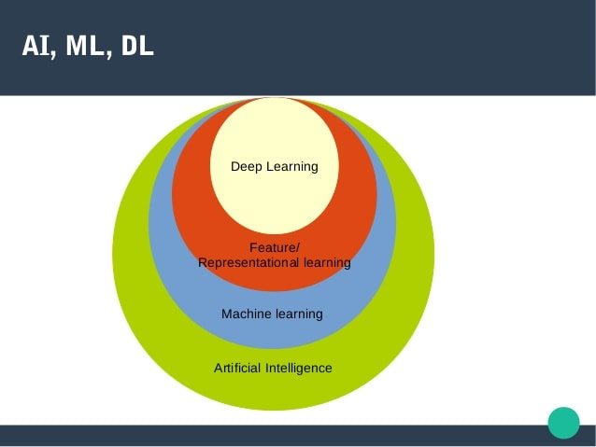

Slide 10
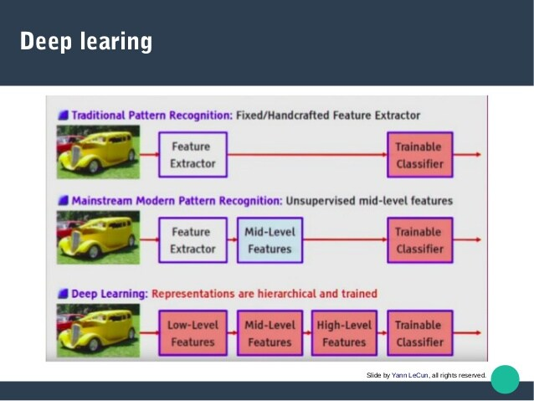

Slide 11
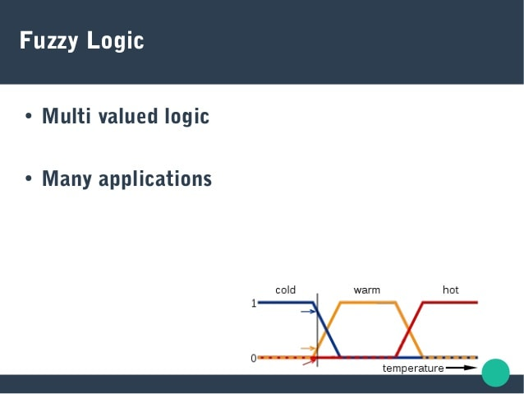

Slide 12
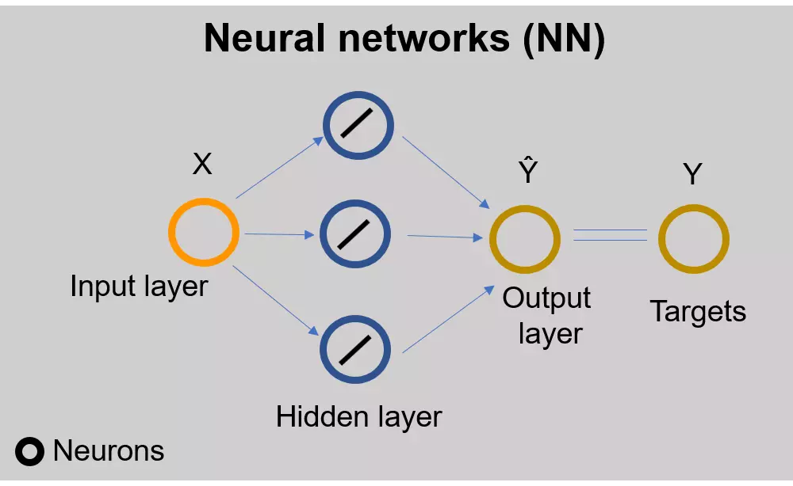
Basics of Neural Networks

Slide 14
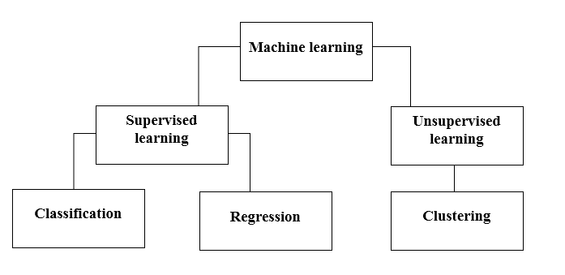

Slide 15
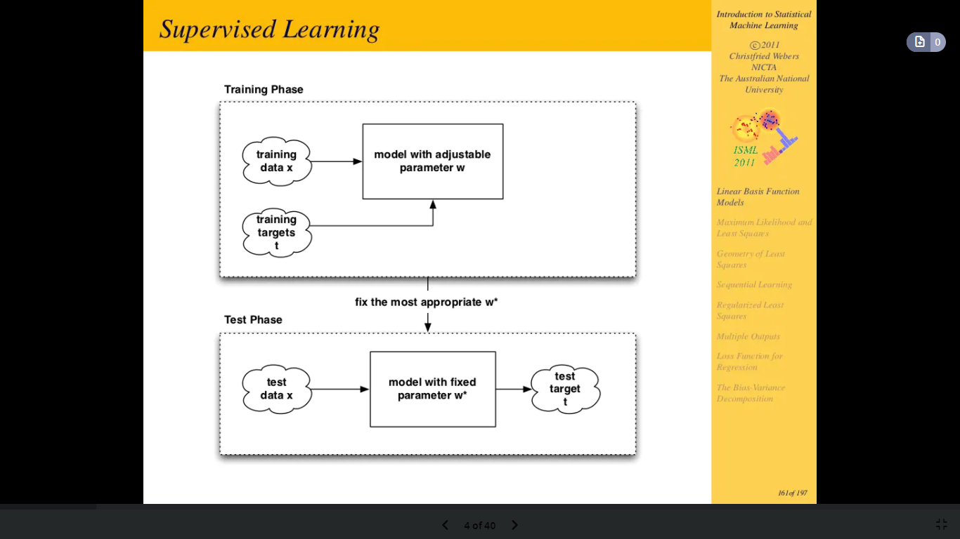

Slide 17
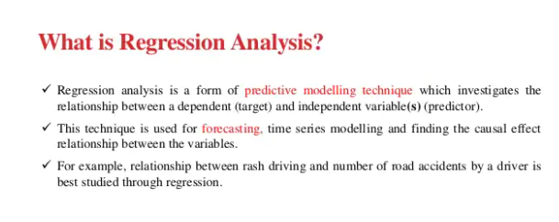
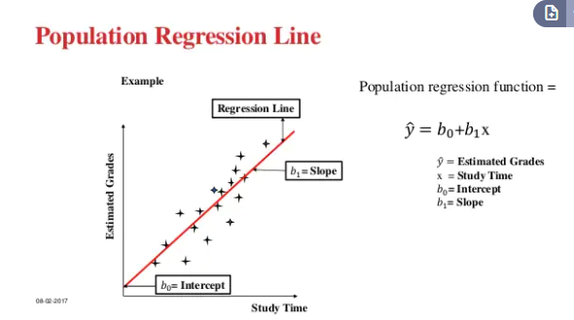
What is linear regression in machine learning?

Slide 18
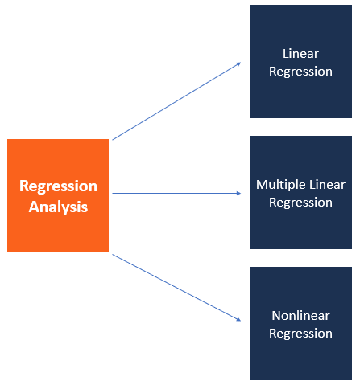
Regression analysis is a statistical method that shows the relationship between two or more variables. Method tests the relationship between a dependent variable against independent variables.

Slide 19
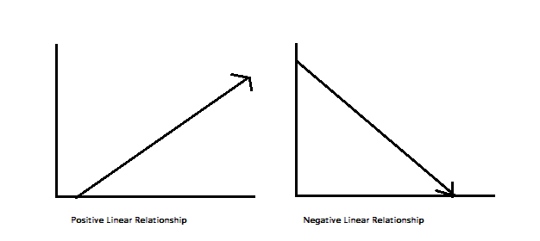
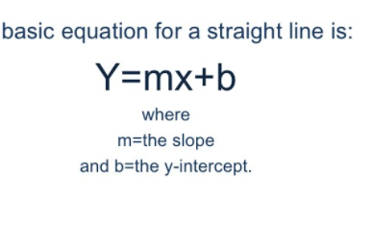
Linear regression
Linear regression is a statistical model that examines the linear relationship between two (Simple Linear Regression ) or more (Multiple Linear Regression) variables — a dependent variable and independent variable(s). Linear relationship basically means that when one (or more) independent variables increases (or decreases), the dependent variable increases (or decreases) too

Slide 20
Linear Basis Function Models
Regression and Classification algorithms are Supervised Learning algorithms. Both the algorithms are used for prediction in Machine learning and work with the labeled datasets. But the difference between both is how they are used for different machine learning problems.
The main difference between Regression and Classification algorithms that Regression algorithms are used to predict the continuous values such as price, salary, age, etc. and Classification algorithms are used to predict/Classify the discrete values such as Male or Female, True or False, Spam or Not Spam, etc.

Slide 21
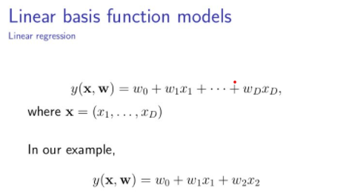
Linear basic function Model
The simplest linear model for regression is one that uses linear combination of input variables
Note: Linear regression (LR) models the linear relationship between the independent (X) variable with that of the dependent variable (y).
To extend the “Class of Model”, we have to consider the linear combination of fixed non-linear function of the input variables

Slide 22
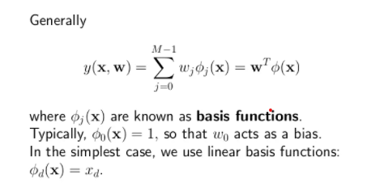

Slide 23
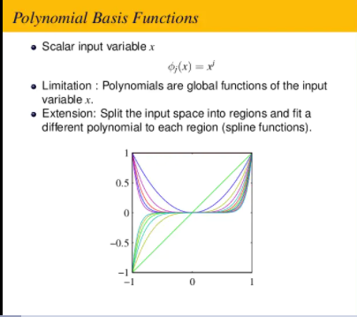

Slide 24
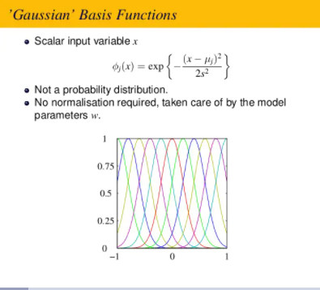

Slide 25
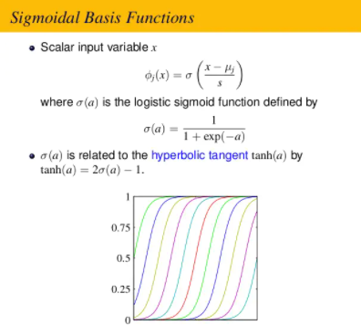

Slide 26
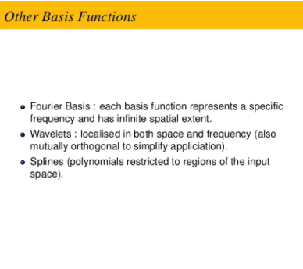

Slide 27
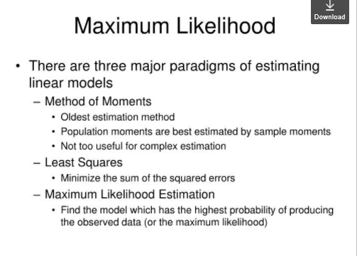
Maximum likelihood

Slide 28
Maximum likelihood estimation (MLE) is a technique used for estimating the parameters of a given distribution, using some observed data. For example, if a population is known to follow a normal distribution but the mean and variance are unknown, MLE can be used to estimate them using a limited sample of the population, by finding particular values of the mean and variance so that the observation is the most likely result to have occurred.
MLE is usually recommended for large samples because it is versatile, applicable to most models and different types of data, and produces the most precise estimates.

Slide 29
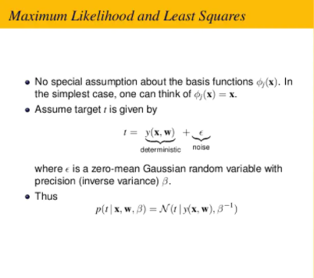
Maximum likelihood and least squares:

Slide 30
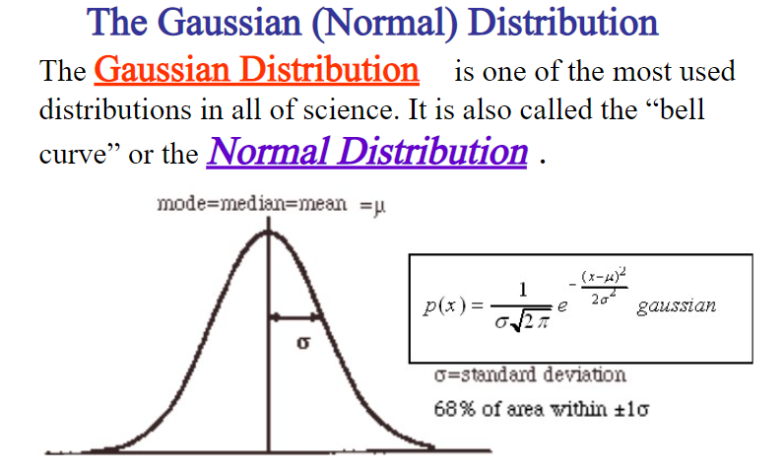
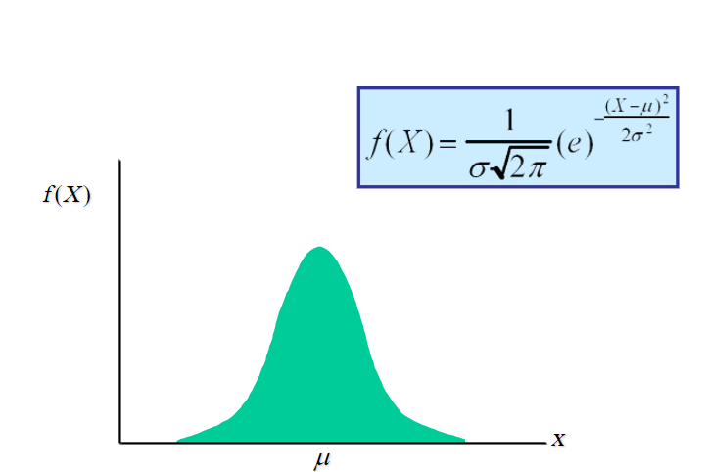
Note: The normal (or Gaussian) distribution is a continuous probability distribution that has a bell-shaped probability density function, known as the Gaussian function or informally as the bell curve.

Slide 31
